Slide 1
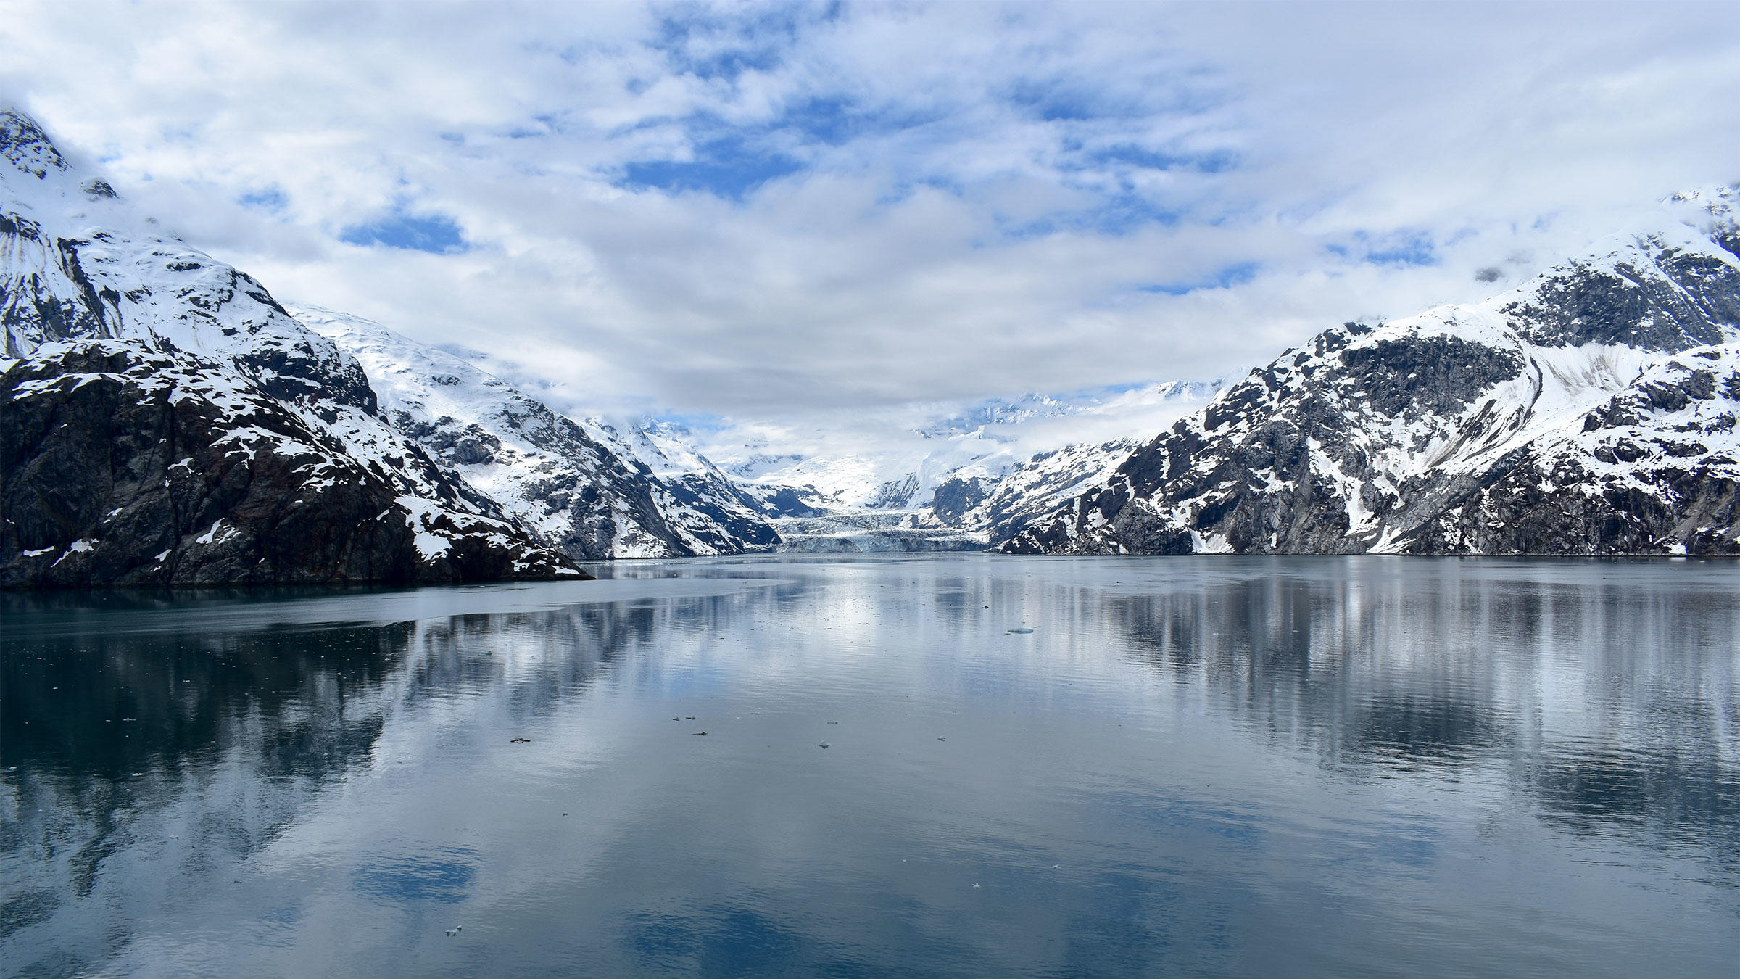
Alaska
Mackenzie Howard
Melissa Salas
Ramiro Hernandez
Megan Taylor
Andrew Gonzalez
Jonalyn Haymes
Nathan Birdsall

Slide 2

Essay Question
What are the positive and negative effects of tourism on Alaska?

Slide 3

Economy
Tourism is major component of the Alaskan economy
Airlines and cruise ships frequently travel to Alaska
Other industries include raw materials and fishing
Gold, diamonds, oil (Primary sector)

Slide 4
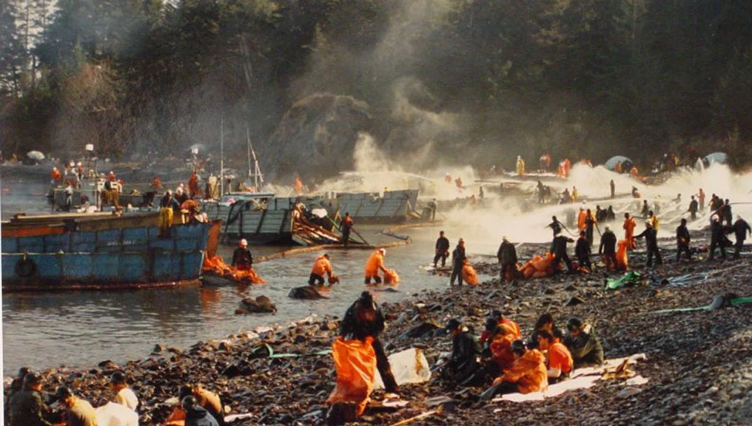
Oil
The State of Alaska has collected $157 billion (in today's dollars) from oil since 1959
State estimates 90 percent of its revenue will continue to come from the oil and gas industry.
33% of Alaskan jobs are tied to the petroleum industry.

Slide 5
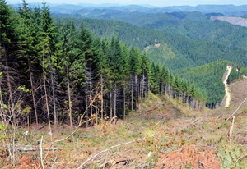
Logging
Second largest industry in the 70s
4,600 jobs in 1990 to approximately 400 logging and manufacturing jobs in 2016.
Harvesting has begun to slow down in all sectors
Continues to outpace growth on private land

Slide 6
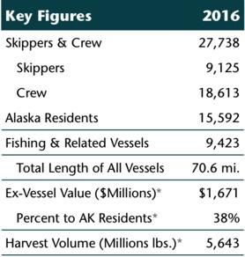
Hunting & Fishing
Nationally, the Alaska seafood industry has a $5.2 billion in annual labor income and a $12.8 billion in economic output.
Alaska exports more than one million metric tons of seafood each year, bringing over $3 billion of new money into the U.S. economy.
Alaska’s fisheries have produced over 169 billion pounds since 1959.
Invasive species, harmful algal blooms, and disease-causing pathogens already are becoming more common and harming indigenous fish
Most hunting seasons in Alaska begin in August and end in September
black bear, brown bear, and grizzly bear,caribou, deer, elk and mountain goat

Slide 7
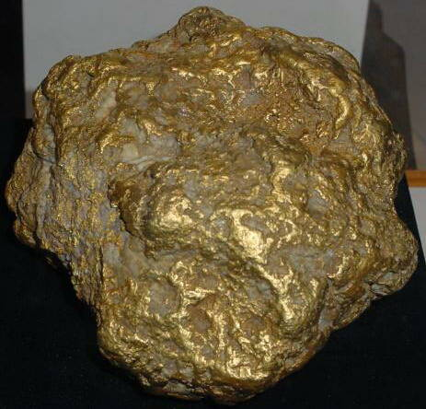
Mining
Gold:
- Highly profitable at $1218 per oz (2018)
-economic advantage/ attracts tourists
- Hardrock mining sites are the largest source of pollution in the United States
- Road access cause issues to the environment
Diamonds:
- added seventeen hundred jobs into the market (diamond sorting, polishing, selling, mining.)
- reduced emissions by using scrubbers
- Carbon Dioxide
Biggest Alaska Nugget: The Alaska Centennial Nugget weighing in at 294.10 oz = $358,213

Slide 8
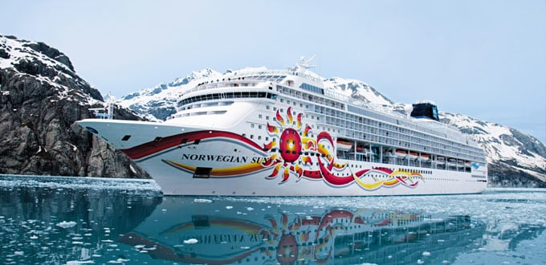
Tourism in Alaska
Helps to provide 38,700 jobs annually.
Generates 1.3 billion in labor income
When tourists visit Alaska, on average they spend $1000/person
Majority of revenue gained from tourism comes from cruises
Mackenzie Howard

Slide 9
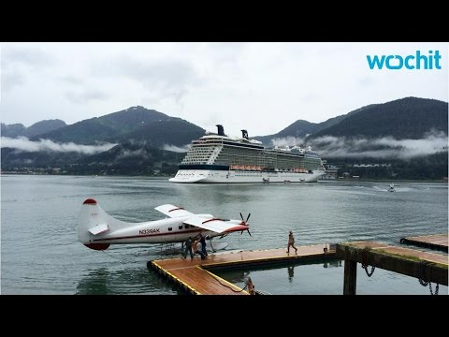
Tourism continued...
Even though tourism generates a lot of revenue for Alaska, it also creates a lot of pollution
Many cruise ships have very sooty emissions that pollute the air and atmosphere
Cruise ships also dump one billion gallons of raw sewage into the oceans every year
Mackenzie Howard

Slide 10
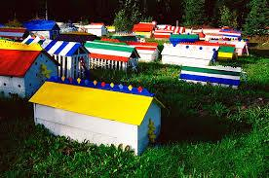
Cultural perspectives
The spirit houses at Eklutna, Alaska, are
unique to the Athabaskan Native people, built
by family members after a death of a love one.
The colors that are placed upon the tops of
the houses, represent clans and crosses
represent the church.
Logging on Native corporation lands account
for over two-thirds of all logging jobs in Alaska.
Melissa Salas

Slide 11
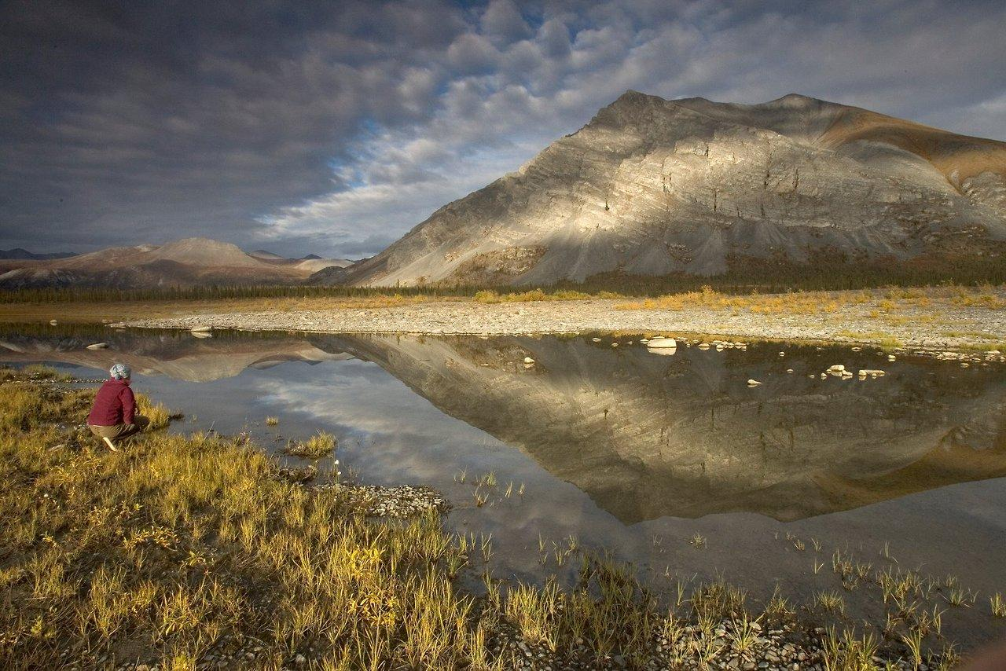
Environment
Arctic National Refuge: largest national wildlife refuge, it is at risk
Main components of the economy also have deteriorated the environment
Mining, logging, and tourism all bring damage to the environment in terms of pollution, habitat destruction, and global warming

Slide 12
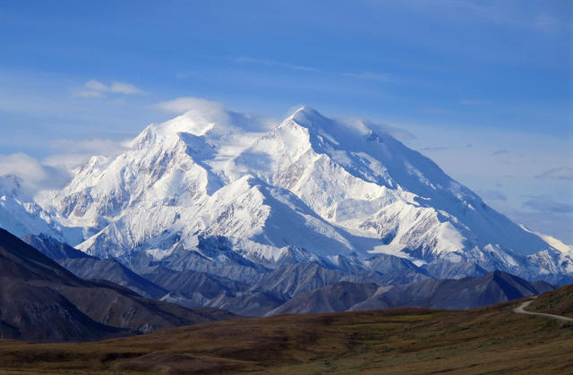
Climate Change
Arctic areas are heating up more than three times faster than the rest of the world.
Increased forest fires, plant disease, and slow the growth of forests
Changes the habitat of many animals leading to death
Even effects humans.
Notes:
Jonalyn
Youtube: https://youtu.be/dV7y1N1oteo

Slide 13
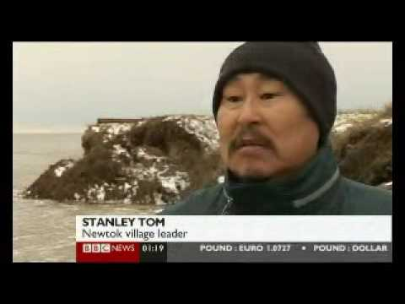
Climate Change:100 Alaskan Villages At Risk From Climate Change
Notes:
Jonalyn
Youtube: https://youtu.be/dV7y1N1oteo

Slide 14
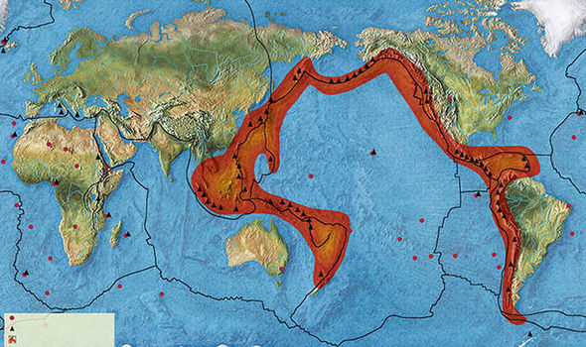
Earthquakes
HIstory of Large earthquakes good friday earthquake March 26 1964 (9.2)
The earthquake lasted approximately 4.5 minutes and became the most powerful recorded earthquake in U.S history.
Leading to a tsunami killing over a hundred people
Notes:
Jonalyn
Youtube: https://youtu.be/dV7y1N1oteo

Slide 15
References
https://www.globalcitizen.org/en/content/cruise-ships-polluters-ocean-sewage-particulates/ (slide 8 and 9)
https://www.alaskaseafood.org/wp-content/uploads/2015/10/AK-Seadfood-Impacts-Sep2017-Final-Digital-Copy.pdf (slide 6)
https://alaskaseagrant.org/wp-content/uploads/2018/02/Climate-Change-and-Fisheries_Johnson_WEB.pdf (slide 6)
http://akmining.biz/mine/nuggets.htm (slide 7)
https://www.akrdc.org/forestry (Slide 5)
http://www.eklutnahistoricalpark.org/ (Slide 10)
https://www.akrdc.org/forestry (Slide 10)
https://earthquake.usgs.gov/earthquakes/events/alaska1964/ (Slide 12)
https://www.fs.fed.us/pnw/pubs/pnw_gtr609.pdf (Slide 5)
https://www.aoga.org/facts-and-figures (Slide 4)

